Slide 1
Situationist International
brief overview

Slide 2
Keep moving. You might never learn who you are—but you do weave yourself into the world, and thereby give the world shape and form.
- KIMSOOJA

Slide 3
What is SI?
Avant-garde movement based chiefly in France. Founded 1957, disbanded 1972.
Chief figures include Guy Debord, Raoul Vaneigem, and Asger Jorn.
United Western Marxist politics with formal experimentation in the visual and literary arts.

Slide 4
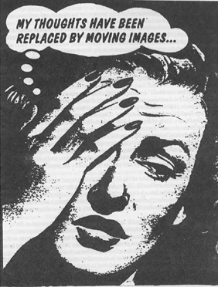
Notes:
The Situationist International (1957–1972) was a relatively small yet influential Paris-based group that had its origins in the avant garde artistic tradition. The situationists are best known for their radical political theory and their influence on the May 1968 student and worker revolts in France. The Situationist International (SI) published a journal called Internationale Situationniste (IS). The two other texts that are essential to an understanding of the SI’s theory are The Society of the Spectacle by Guy Debord (the SI’s leading theorist throughout its existence) and The Revolution of Everyday Life by Raoul Vaneigem.

Slide 5
Notes:
The SI’s influence in the United States is most noticeable in the anarchist milieu. The situationists, however, were not anarchists. “All kinds of recent experiences have shown the recuperated confusionism of the term ‘anarchist,’ and it seems to me that we must oppose it everywhere,” wrote Debord in 1968. The situationists could be termed anti-state communists: they were heavily influenced by Marx and did not identify with the anarchist tradition, yet shared the anarchist opposition to the state. (The situationists, however, did not call themselves communists due to its popular association with Communist Parties.)

Slide 6
Notes:
It is important to understand the SI in relation to Marx, to see how they saw their own project as a continuation of Marx’s critique of capitalism (and this essay will certainly focus on this). “The philosophers have only interpreted the world, in various ways; the point is to change it,” wrote Marx. “So far philosophers and artists have only interpreted situations; the point now is to transform them,” wrote the SI.

Slide 7
Proposed Solutions
DÉTOURNEMENT. French for “un-turning.” The strategic defacement, meddling, or transformation of “spectacles” in order to expose their falsity and absurdity and thereby deprive them of their authority, naturalness, and inevitability.
DÉRIVE. French for “drift.” Walking or otherwise acting without predetermined aim or goal. Cut across, ignore, or transgress all artificial barriers, physical or conceptual.

Slide 8
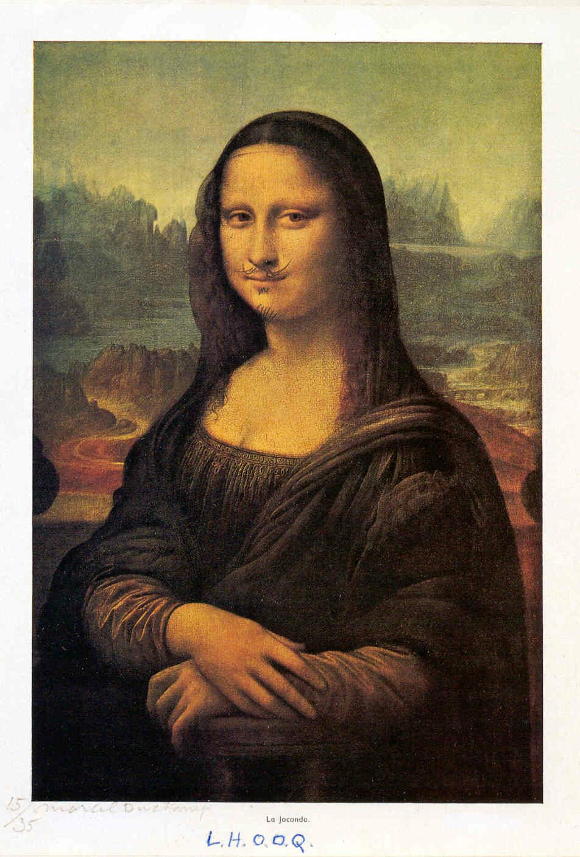
Détournement
Adbusters Magazine American Flag
Duchamp - LHOOQ (1919)
Notes:
L.H.O.O.Q., which sound out the French sentence: "She has a hot arse.”
Sigmund Freud had psychoanalysed Leonardo's art and related the artist's inability to finish his works to the sublimation of his sexual life to art. He also argued that Leonardo was homosexual.
Duchamp's Mona Lisa is a Freudian joke. Duchamp reveals, in a simple gesture, that which the painting conceals. But this is not merely an allusion to Freud. Duchamp uncovers an ambiguity of gender at the heart of Leonardo's aesthetic - that Leonardo sees the male form in the female.

